Slide 1
Emotion recognition in images From idea to a model in production
Hagay Lupesko
Pedro Larroy Amazon AI
©2018 Amazon Web Services, Inc. or its affiliates, All rights reserved
Notes:
Hi everyone!
My name is Hagay Lupesko, I’m an engineering manager with Amazon AI, and I’m working with my team on the area of Deep Learning Systems.
I this workshop, I will be taking you through a journey, from incepting an AI model, through cleaning the data, building the model, training it, and all the way to deploying it as a service. I chose the problem of facial expression recognition, but it is pretty much an arbitrary choice, and we could have chosen other models.
By the end of this session, you will know the basics of taking an idea for an AI model, and building it up all the way to production – so make sure you are listening carefully ☺
Feel free to ask questions during the talk, and if you want to chat some more -I'll be here after the talk.

Slide 2
Brief Intro to Deep Learning
Can machines think?
Can machines do what we can? (Turing, 1950)
AI
Machine Learning
Deep Learning
Data
Data
Machine Learning
Traditional Programming
Rules
Answers
Answers
Rules
Notes:
OK, let’s get going. We'll start with a brief intro to deep learning to understand what it is and why it matters.
With a show of hands – How many of you have experience with ML? know what Deep Learning is? How many have ever implemented a neural network? How many have deployed one to production?
Let’s start with AI. AI is an active research area dating back to at least the 50s if not earlier. Investigating the various aspects of enabling machines to mimic, and surpass, human intelligence. Alan Turing, a computing pioneer, calibrated the essence of AI by moving from the philosophical question “can machines think” to a more relevant question “can machines do what us humans can?”
ML is a subset of AI, and is really a different programming paradigm. Traditional programming, that is mostly taught at schools, is about us humans programming rules, and the machine executing these rules on data to provide answers. ML is taking in data and answers, and constructs the rules by itself. This is closer to how humans learn from experience.
So ML is the set of techniques that enables machines to learn rules from data, without being explicitly programmed. ML is really an umbrella term that includes algorithms like decision trees, SVM and also neural networks.
This takes us to Deep Learning. DL is a subset of ML, a technique inspired by the human brain – or neurons to be more exact – that uses interconnected artificial neurons to learn from samples.

Slide 3
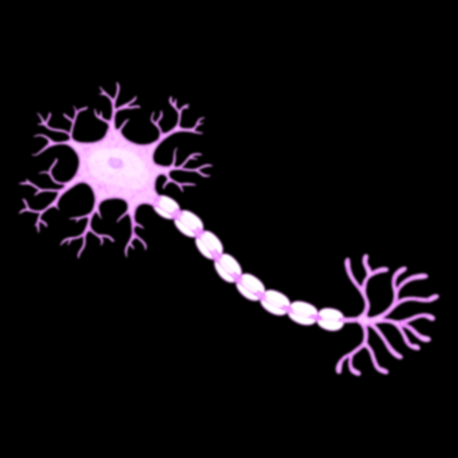

Brief Intro to Deep Learning – Artificial Neurons
Inspired by the brain’s Neurons
We have ~100B of them, and ~1Q Synapses
Inputs
Weights
Non-Linear Activation
x₁
w₁
$$y= φ(\sum_{j=1}^{n}{wjxj)}$$
Σ
φ
𝑦
x₂
w₂
…
x_{n}
w_{n}
Notes:
So at the base of Deep Learning there is the artificial neural network, and at the base of that there is the artificial neurons.
Artificial neurons are inspired by the human brain’s neuron cells. These cells are abundant in the brain, we have ~100B of them, they receive, process and transmit information through electrical and chemical signals. They are connected to one another via Synapses, which we have ~1Quadrillion of (that’s 1000 trillion) – and form neural networks that are responsible for much of our brain and spinal cord activities.
Artificial neurons are only inspired by real neurons, actual design and implementation differs significantly. In fact, the AN construct is pretty simple:
We have inputs coming into the AN, and each input has a weight parameter assigned to it. There is a linear combination of the input vector and the weight vector, and the output scalar is fed into a non linear function that then spits out another scalar. The non-linear function is very important, since it makes the overall network able to handle non-linear features.
That’s it. This output is, in turn, becoming one of the input of another neuron.

Slide 4
Brief Intro to Deep Learning – Neural Networks
Non linear
Hierarchical feature learning
Scalable architecture
Computationally intensive
Many More…
Input Layer
Hidden Layers
Output Layer
Notes:
Now, a Neural Network at its most simplistic form is composed of layers, each consisting of a set of artificial neurons, that are interconnected across layers with weighted edges. The term “deep learning” was coined due to these networks having many hidden layers, which makes them “deep”. The network takes the input vector, matrix, or more generally tensor, and feeds every element of the input into a unit in the input layer. From there the computation cascades across the units and layers, until we get an output in the output layer. Neural networks are non linear functions, and can learn non linear features, as the activation functions in each neuron is non linear. They enable learning features in a hierarchical way, with each layer learning a feature that is leveraging the features learned in the previous layer. And very importantly: it is a scalable architecture that can be made more complex with more learning capabilities by enlarging the network and/or modifying the operators in neurons. And it is typically very heavy computationally. Modern networks such as resnet-152 have hundreds of layers and requires billions of FLOPs to compute just a single prediction.

Slide 5
Training Neural Networks
Forward Pass
Input Data
Neural Network
Inference
Backwards Pass
Update Weights
Back Propagate
Loss
Backwards Pass is where the magic of learning happens, leveraging Gradient Descent.
Notes:
The difficult part is training the network, so we can find the right weights that will approximate the function modeling the problem we are trying to solve.
We start with the “Forward Pass”, in which we take a sample from our labeled input data, feed it through the network to get the inference, or prediction result.
We then do the “Backwards Pass”, also called “Backprop”, where we calculate the loss, i.e. how bad did the network did compared to the “Ground Truth” – the label of the sample input data – and then we back propagate the loss across the network, finding the gradients of each weight to identify the direction of the error.
We then update the weights across the network, in a direction opposite to the gradient, and in a value that is typically a fraction of the gradient – this fraction is called the “Learning Rate”.
The Backwards Pass is where learning happens. Through repeated iterations, we are leveraging the gradient to take down the loss, until we converge into a low error rate.

Slide 6
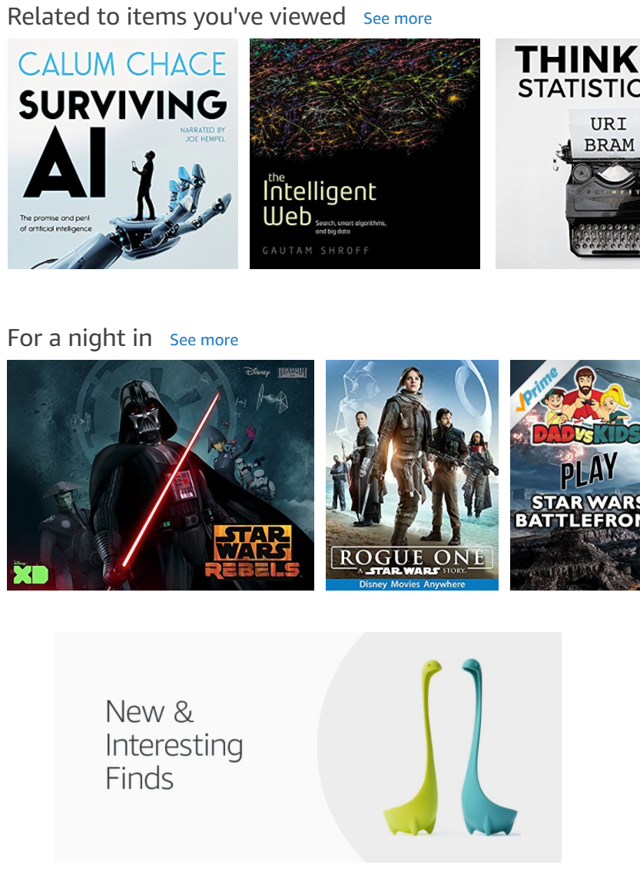
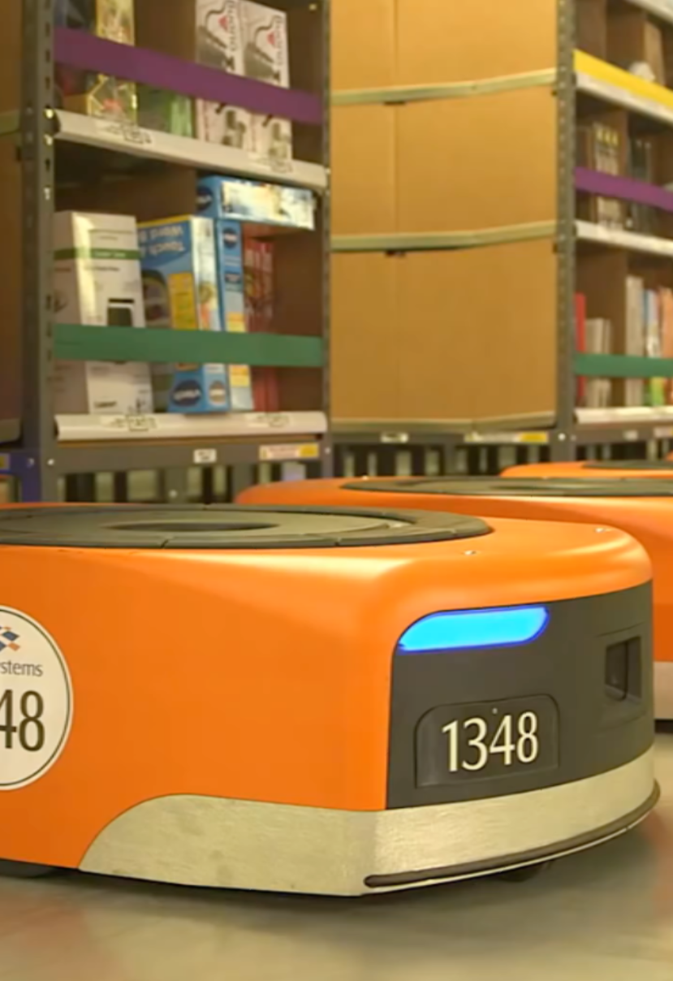
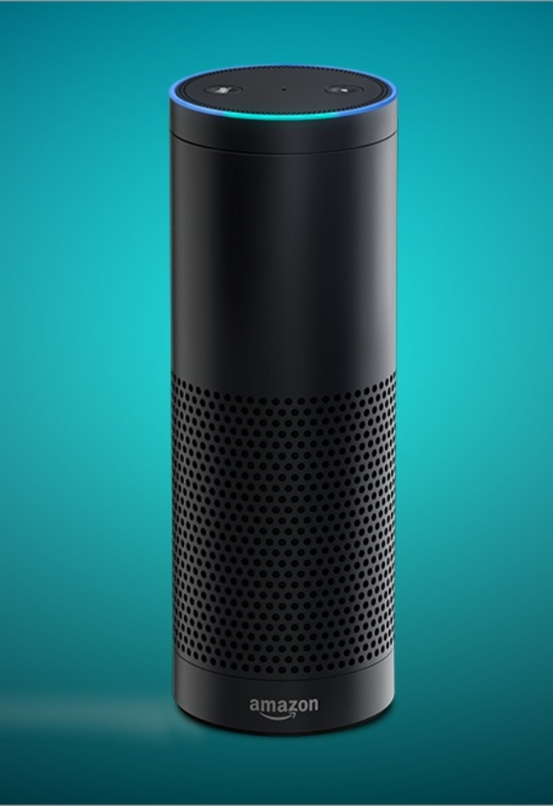
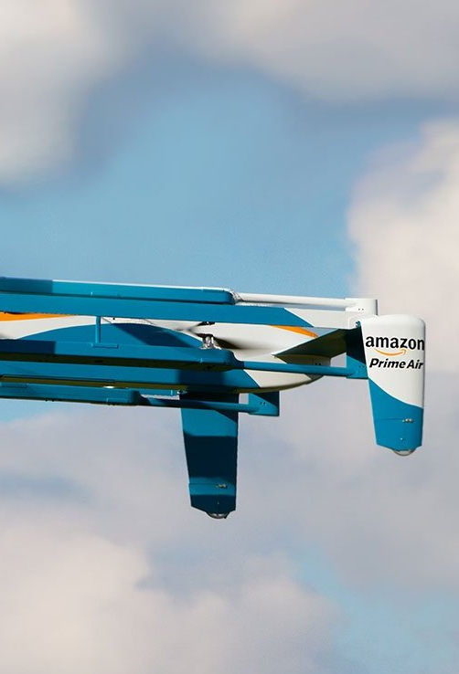
Deep Learning is a Big Deal
It has a growing impact on our lives
Autonomous Vehicles
Personalization
Logistics
Voice
Notes:
A bit about why Deep Learning is a big deal
You can see Deep Learning applied in more and more domains, with a growing impact on our lives.
If you look at the breadth of AI applied within Amazon alone, you can see DL in the Retail Website within personalization and recs, you can see it optimizing Amazon’s logistics, you probably noticed the boom voice-enabled personal assistants, and you may have heard that Amazon drones also rely on deep learning, just as other autonomous vehicles tech is relying on it. And of course the list goes on.

Slide 7
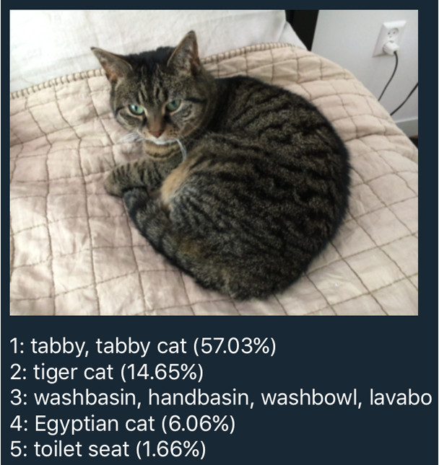
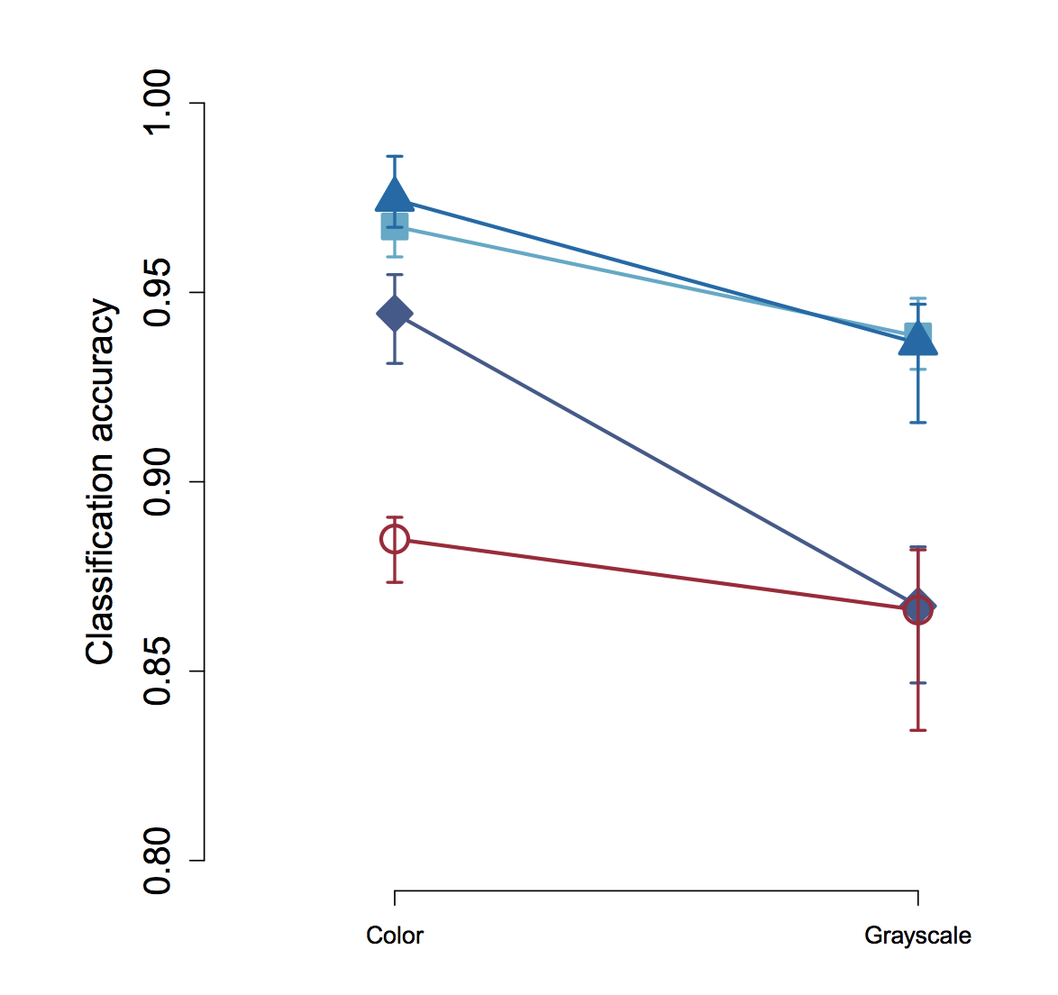
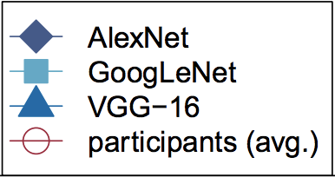
Deep Learning is a Big Deal
It’s able to do better than humans (and ML)
Notes:
Beyond the growing usage of DL in applications and devices around us, there is another interesting aspect to deep learning, and that is how well it does compared to the dominant species on this planet: us!
One of the first areas Deep Learning was able to demonstrate state of the art results, was in the domain of Computer Vision. A classical problem in that domain is Object Classification: given an image, identify the most prominent object in that image out of a set of pre-defined classes. A DNN presented in 2012 by Alex Krizhevsky, was able to leap-frog the best known algo to date by over 30%. That was really a major leap, and since then every year the best algorithm for Object Classification, and many other Vision tasks, are based on Deep Learning, with results that keep on getting better. Research paper by Geirhos from 2017 shows that DNNs already outperform humans in Object Classification – a task us humans have been programmed to specialize in by evolution. The paper also shows that human vision actually performs better when noise is introduced – it may make you feel better, it worked for me ☺
AlexNet paper: https://papers.nips.cc/paper/4824-imagenet-classification-with-deep-convolutional-neural-networks.pdf
Humans vs DNNs paper: https://arxiv.org/pdf/1706.06969.pdf

Slide 8
Facial Expression Recognition
Notes:
OK. Now that we have the background, let's try to solve a problem that is hard to solve with traditional programming, but one that deep learning is especially good at: Facial Expression Recognition.

Slide 9
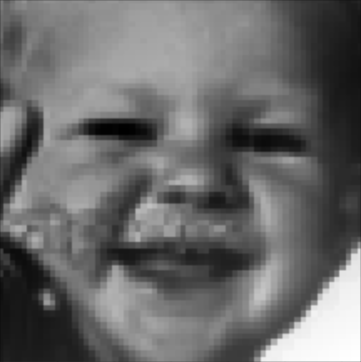

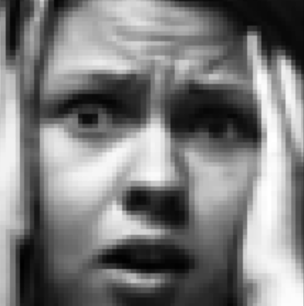
Problem Statement
Given an image of a human face, classify the emotion expressed.
Happiness
Surprise
Fear
?
?
?
Notes:
As is the case with quite a few hard problems, defining it is pretty easy: given an image of a human face, classify the emotion expressed.
Let's give it a try folks.
Let's start with the first image to the left: any guesses?
Second?
Third?
In fact, this is not an easy problem for humans as well, and to get descent labeling out of human crowd sourced classifiers, we need almost 10 human taggers per sample!

Slide 10
Problem Modeling
Given an image of a human face, classify the emotion expressed.
image → Convolutional network
classify → Classification head and loss
FER+ → Barsoum et al. of Microsoft Research
Notes:
OK, now let's model our problem a bit. - This is a problem that involves images as input - so we're probably interested in some sort of convnets. Who here is familiar with convnets? we can explain more about convnets and 2D conv layers later.
- We would like to classify our input into a few classes, each representing emotion expressions - so we'll need a classification head for our model such as a Softmax, and a classification loss function. Who's familiar with Softmax? - Lastly, a short research on the web will reveal that this problem was already researched and solved - FER and more recently FER+ from Microsoft Research. FER was posted on Kaggle ~4 years ago, and in our lab session, we will beat the best result on Kaggle by more than 10%, using deep learning and conv nets. This lab session is based on the model proposed by Barsoum et al in their FER+ paper.

Slide 11
Engineering Our Way from Idea to Production
Research
SoTA
Data Prep
Data acquisition
Model
Neural arch
Train
Deploy
Pre-trained
Clean
Augment
Preprocess
Loss
Hyper parameters tuning
GPUs
Endpoint setup
Scaling
Papers
Notes:
Before we jump into the lab, let's go over the process by which we are realizing and productionizing ideas. We start with research of the state of the art, papers, implementation, and in best case scenarios - pre-trained models we can just use! We then handle the critical yet sometimes boring work of preparing the data our model will train on. Remember - your model is only as good as your data! Next we define and build our model architecture, loss function and initial hyper parameters. Then we train our model, depending on the model and hardware you have access to, this can take quite some time. Use GPUs where possible! Lastly - to take our model to production we'll need to deploy it, and scale as needed. We'll go over these in our lab.

Slide 12

Apache MXNet - Background
Apache (incubating) open source project
Framework for building and training DNNs
Created by academia (CMU and UW)
Adopted by AWS as DNN framework of choice, Nov 2016
http://mxnet.io
Notes:
In this lab, we will use Apache MXNet as our deep learning franework. With a show of hands: who is familiar with MXNet? So just a bit of background on MXNet:
It is an Apache open source project. People sometimes think it is an “Amazon Project” but it is not. It is truly open source, decisions are made by the community. However, it is true that AWS is contributing a lot to the project.
It is a framework for building, training and using DNNs for inference. Similar to TF, PyTorch, etc.
It originated in the adademia, CMU and UW
Aws adopted MXNet late 2016 as “DL FW of choice), there’s a nice blog post by AWS CTO (Vogels) explaining more in details. A lot of it is about scalability and MXNet being good for production use.

Slide 13
Apache MXNet - Highlights
Ease of Use
Imperative, Symbolic and Dynamic APIs
Performance
Optimized for CPU, GPU, ARM (and more)
APIs in Python, Scala, C, C++, R (and more)
Toolkits for CV, NLP and lots of examples
Portability
Train on cloud, predict on edge
Highly scalable distributed training
Keras backend support, ONNX support
Quantization, Sparse, NCCL, and more…
Model serving framework

Slide 14


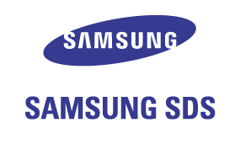
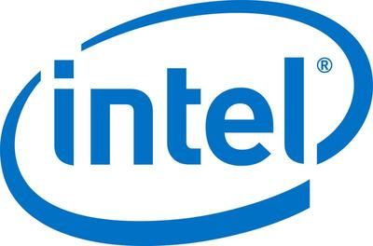


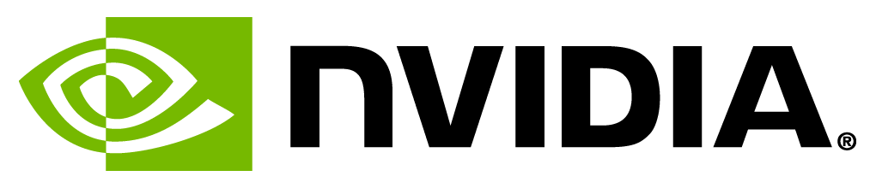















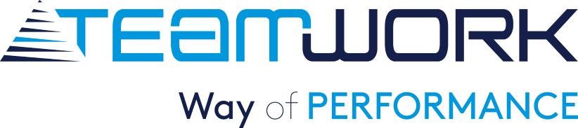





MXNet Customer Momentum

Slide 15
Lab: Model Training with Apache MXNet
https://bit.ly/2pViepR
Notes:
And now - let's start the lab!

Slide 16
Introduction to Model Serving for Apache MXNet
Notes:
Before we start the deployment lab, I'd like to provide some background about the tool we will use for deployment: Model Server for MXNet, or MMS for short.

Slide 17
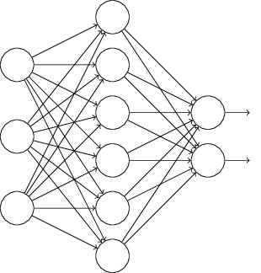
So what does a deployed model looks like?
Model
Mobile
Internet
Model Server
Desktop
IoT
Notes:
So, how do you actually use a deep learning model in your production environment?
Let’s start with the outcome we’re trying to achieve. In fact, it is pretty straight-forward, and is not very different than deploying any other service.
We have a trained model, that we want to use for inference,
We have a bunch of clients: mobile, desktop, iot, cloud – or any combination of those
We want to have a server of sorts, hosting a trained model, exposing an inference API, which when called runs a feed forward through the network doing the deep learning “magic” Naveen explained earlier.
That’s a very simple schema of model serving setup.

Slide 18
The Undifferentiated Heavy Lifting of Model Serving
Performance
Networking
Monitoring
Model Decoupling
Cross Framework
Cross Platform
Availability
Model Server for MXNet
Notes:
As we saw in the previous slide, in many ways, serving deep learning models is similar to other, more traditional, serving frameworks out there, such as Apache Tomcat. And indeed in many ways, Model Serving is undifferentiated heavy lifting. That is a term we use and focus on in AWS a lot. What it means is all of the aspects that are necessary to get the job done, but that are not differentiating your business, things like setting up servers, networks, etc. is all UHL.
Let’s quickly go over the main concerns Model Serving system needs to address:
- Performance – this concern is about providing a scalable architecture that is able to meet target TPS, making an efficient use of the available compute resources, strike the right balance between throughput and latency. It is especially important for Deep Learning, since the computational load of running a single inference is typically significant. As a reference, a model such as ResNet-152 requires billions of FLOPs for a single forward pass.
Availability – to make your application working properly all the time, you want to minimize down time, and avoid offline status when load is high, or when you are busy deploying a new model.
Networking – making your model consumable means you need to expose a network endpoint that clients can call to get predictions. This endpoint needs to support standard interfaces such as HTTP, error codes, security and more.
Monitoring – having any service in production means you need the ability to look into your operational metrics in near-real time; things like resource utilization on host, inference latencies, requests and errors.
Model Decoupling– when you are serving models you want to offer a way that enables to use trained models without knowing anything about their inner working details. The model may be identifying cats in images, or doing sentiment analysis. No change should be done to the server beyond deploying a different model.
Cross Framework – there are many different Neural Network frameworks: MXNet, TensorFlow, PyTorch, Caffe, and more. “Same Same, But Different” - all similar, but different in style and implementation details. We want a model server that just works, regardless of the framework used to build and train the model.
Cross Platform – similar to how there are many frameworks, there are also many platforms you can run your server on. From the OS (Linux, Windows) to the actual compute processor which can be a CPU, a GPU or a TPU.
And beyond all of that, one uber-concern that is an important meta concern is Ease of Use – all of the concerns just mentioned needs to be addressed in a way that is easy to use, quick to learn, and just work!

Slide 19
Model Server for Apache MXNet
Machine learning model server
Serves MXNet models – and more!
Automated HTTP endpoints setup
Scales to multiple CPUs and GPUs
Management API
Pre-built and configured containers
CLI to package model artifacts for serving
Open source project under AWS Labs
http://modelserver.io
Notes:
A bit of background on MMS:
It is an Apache open source project. People sometimes think it is an “Amazon Project” but it is not. It is truly open source, decisions are made by the community. However, it is true that AWS is contributing a lot to the project.
It is a framework for building, training and using DNNs for inference. Similar to TF, PyTorch, etc.
It originated in the adademia, CMU and UW
Aws adopted MXNet late 2016 as “DL FW of choice), there’s a nice blog post by AWS CTO (Vogels) explaining more in details. A lot of it is about scalability and MXNet being good for production use.

Slide 20
Model Archive
Trained Network
Model Signature
Model Archive
Model Export CLI
Custom Code
Auxiliary Assets
Back

Slide 21
Lab: Model Serving with Apache MXNet
https://bit.ly/2pViepR

Slide 22
Workshop Retrospective
Research
Data Prep
Data acquisition
Model
VGG13
Train
Deploy
Clean
Augment
Preprocess
Hyper parameters tuning
GPUs
Used MMS to deploy
FER on Kaggle
FER+ Paper
Updated model head
Chose a loss function
Custom processing code
Notes:
Going back, here’s a recap of what we did in this workshop

Slide 23
Demo: FER Web app backed by Apache MXNet and AWS Elastic Container Service
http://bit.ly/mxnet-fer
Notes:
I hope you enjoyed this session so far! An intern on our team, S.K., had built a web app on top of MMS and AWS Container Service, that has a nice front-end you can play around with. Let's check it out, and feel free to share with your friends.

Slide 24
Apache MXNet Resources
MXNet: http://mxnet.io
Model Server: http://modelserver.io
CV toolkit: https://gluon-cv.mxnet.io
NLP toolkit: https://gluon-nlp.mxnet.io
Medium: https://medium.com/apache-mxnet
Twitter: @ApacheMXNet
Wiki: https://cwiki.apache.org/confluence/display/MXNET
Subscribe to dev list – dev@mxnet.incubator.apache.org
To adopt in your organization: mxnet-info@amazon.com

Slide 25
Evaluating Apache MXNet
Want to learn more and start using MXNet?
Our experts can review your use cases
We will help you with an evaluation of MXNet
We can walk you through the steps to get to production
Partner with AWS!
Become a customer reference
Write a blog and receive market and peer recognition
Customer case study to promote what you’re doing in Deep Learning
To get started: mxnet-info@amazon.com

Slide 26
Try it out, Star and Contribute!
http://mxnet.io
http://modelserver.io

